Slide 1
Practical Review on the Evolution of Cybersecurity
Week 1: What have you learnt so far?

Slide 2
Keynote: The Capeless Hero
CYBER
The main objective of security is to protect organisations and people.
This line of work allows you to support and interact with people across the globe.
This program is designed to give you the knowledge and skills you need to start and progress in the security profession.
CYBER
FUTURISTIC
SECURITY

Slide 3
Not All Heroes Wear Capes Some wear Hoodies

Slide 4
About Cyber Security
01
Why are you learning cybersecurity?

Slide 5
Keynotes
CYBER
Take the example of a storm
What do you do when you’re informed of a storm coming?
During the storm, What do you do if you have a leaking roof?
Handling a security incident is no different.
CYBER
FUTURISTIC
SECURITY

Slide 6
Don’t be afraid of the tech You only need interest and dedication

Slide 7
?
What is Cyber Security?

Slide 8
—Someone Famous
Cybersecurity is the practice of ensuring confidentiality, integrity, and availability of information by protecting networks, devices, people, and data from unauthorized access or criminal exploitation.

Slide 9
The Evolution
02
How did we evolve from no threats to cyber threats?
What can you learn from the evolution

Slide 10
Brief Timeline
1971
1989
2000
In 1971, the message “I’m the creeper, catch me if you can” greeted several users of the ARPANET, one of the earliest forms of the internet.
In 1989, when the first recorded Denial-of-Service attack in history occurred, Morris worm.
when over ten million Windows users were infected with the ILOVEYOU bug. The fastest-spreading worm in computer history, at that time.

Slide 11
Brief Timeline
1995
2002
2003
The SSL 2.0 version that was released in ’95 was the bedrock for ‘HTTPS,’ which you’ll often see at the beginning of web addresses - when browsing securely.
The U.S. Department of Homeland Security was established
The first infamous group of hackers with a vast network of users with seemingly no leader, often acting in the interest of protecting the privacy of the everyday person

Slide 12
Those who do not learn from history are… probably studying politics in uniport

Slide 13
03
Importance of Cyber Security

Slide 14
Discuss the importance of cybersecurity in today's digital world using practical examples.
Activities
Class
Assessment
Assessment

Slide 15
Personal Data Protection
Identity Theft: Cybercriminals can steal personal information like names, addresses, and social security numbers to open fraudulent accounts and commit identity theft.
Financial Loss: Unauthorized access to bank accounts or credit cards can lead to significant financial losses.

Slide 16
National Security
Critical Infrastructure: Attacks on critical infrastructure, such as power grids or transportation systems, can have severe consequences for national security.
Espionage: Cyberespionage can compromise sensitive government information and undermine national interests.

Slide 17
Intellectual Property Theft
Trade Secrets: Companies invest heavily in research and development, and their intellectual property can be a valuable target for cybercriminals.
Competitive Advantage: Loss of intellectual property can erode a company's competitive advantage.

Slide 18
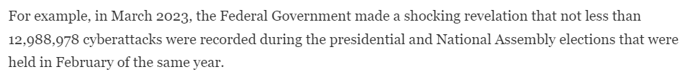
Practical Examples of Cyberattacks

Slide 19
Quiz Section
Activities
Class
Assessment
Assessment

Slide 20
A social engineering attack that tricks users into revealing personal information?
Yahoo
Ransomware
Phishing
Virus

Slide 21
Which of the following is a characteristic of a Ransomware attack?
Encrypting files and demanding payment for decryption
Stealing sensitive data without detection
Creating fake websites to trick users into entering personal information
Spamming users with unwanted emails

Slide 22
What is a DDoS (Distributed Denial of Service) attack?
An attack that installs malware on multiple devices
An attack that disrupts normal traffic of a network by overwhelming it with a flood of internet traffic
A targeted attack to steal financial information
A method of securely sharing data across multiple servers

Slide 23
What is the primary purpose of a firewall in cybersecurity?
To block all incoming internet traffic
To filter and monitor incoming and outgoing network traffic based on security rules
To encrypt data sent over the internet
To create strong passwords for users

Slide 24
Practical Examples of Cyberattacks
Ransomware: Attackers encrypt a victim's data and demand a ransom for decryption.
Phishing: Attackers send emails or messages that appear legitimate but contain malicious links or attachments.
SQL Injection: Attackers exploit vulnerabilities in websites to gain unauthorized access to databases.
Distributed Denial of Service (DDoS) Attacks: Attackers overwhelm a target's network with traffic, making it inaccessible.

Slide 25
Common Vulnerabilities, Threats and Risks
04

Slide 26
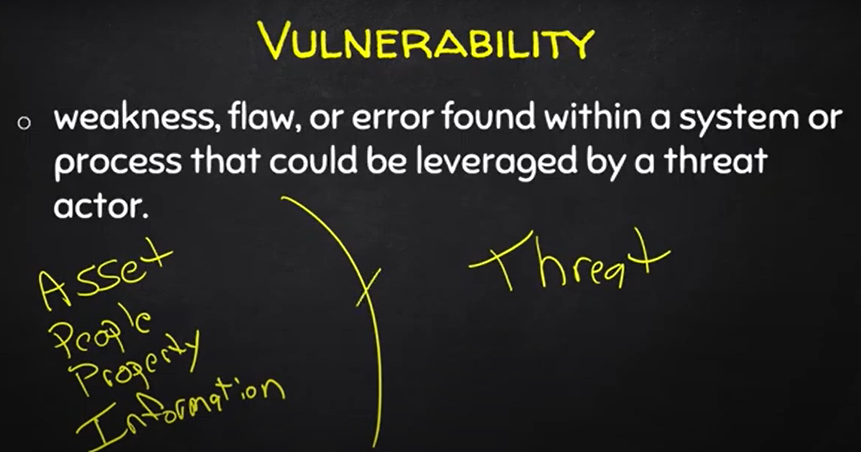
Purpose statement

Slide 27
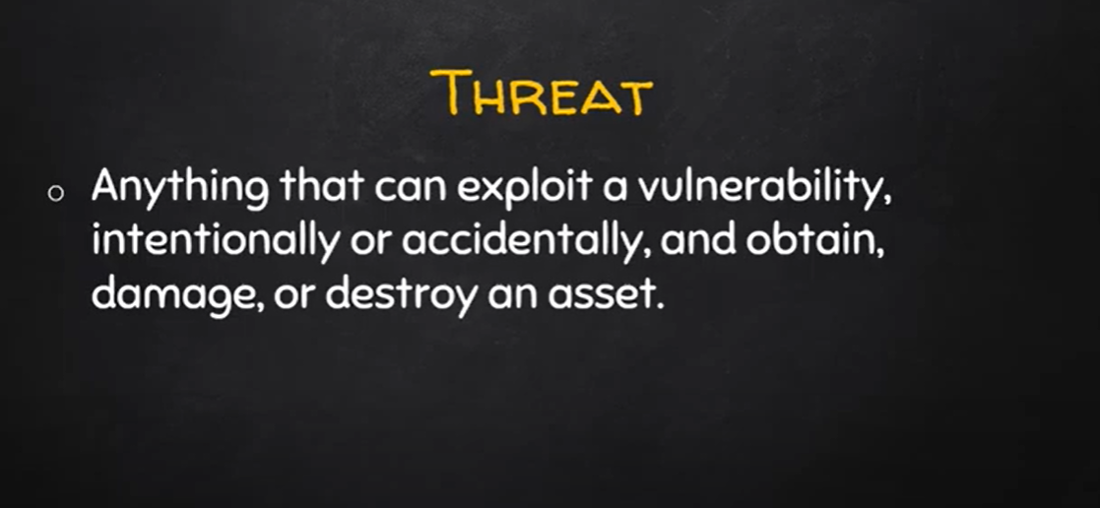
Purpose statement

Slide 28
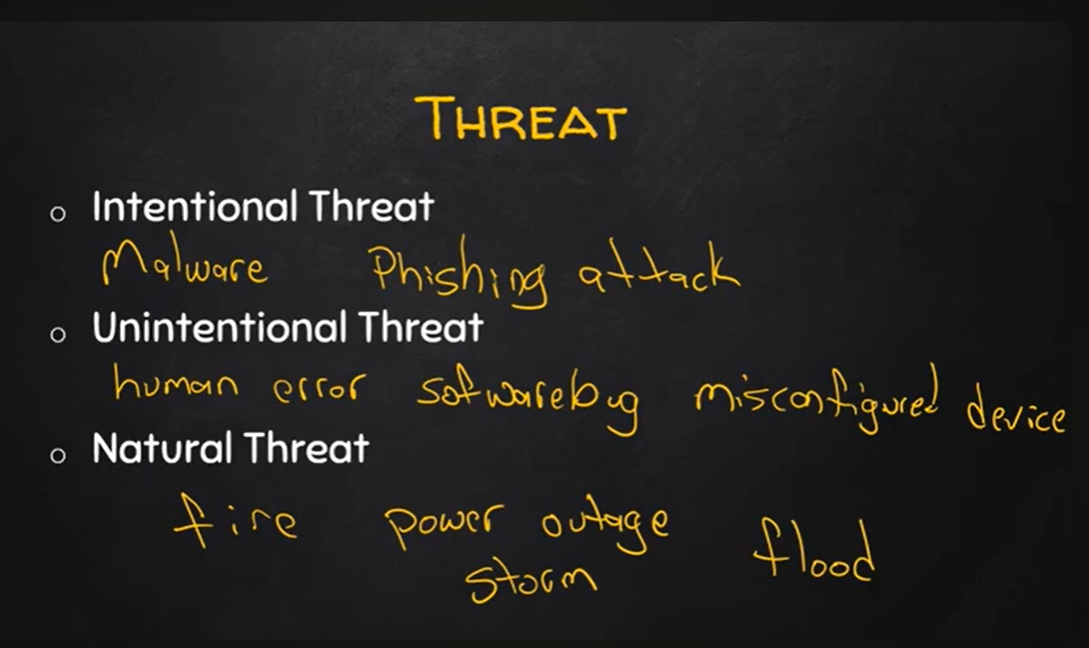
Purpose statement

Slide 29
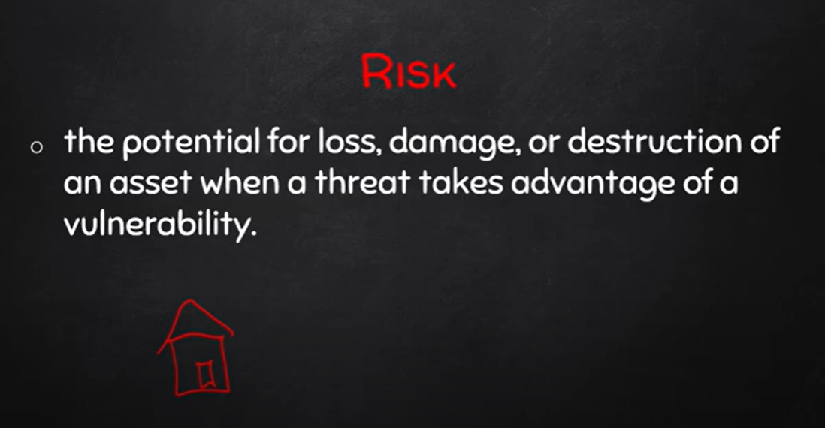
Purpose statement

Slide 30
Case Study Analysis
In 2017, Equifax, one of the largest credit reporting agencies, announced a data breach that exposed the personal information of approximately 147 million people. The breach was caused by a failure to patch a known vulnerability in a web application. The exposed data included names, Social Security numbers, birth dates, addresses, and, in some cases, driver's license numbers and credit card details.
Questions:
What was the primary cause of the Equifax data breach, and how could it have been prevented?
Analyze the ethical responsibilities of companies like Equifax in protecting consumer data. How should they handle the aftermath of such a breach?

Slide 31
Case Study Analysis Answers
Question 1
The primary cause of the Equifax data breach was the failure to patch a known vulnerability in the Apache Struts web application framework. The vulnerability (CVE-2017-5638) had been disclosed months earlier, but Equifax did not apply the available security patch promptly. This allowed attackers to exploit the vulnerability and gain access to Equifax's systems, leading to the exposure of sensitive personal information of 147 million people.
The breach could have been prevented by:
Timely Patch Management
Automated Patch Management Tools
Vulnerability Scanning and Monitoring
Strong Security Governance

Slide 32
Case Study Analysis Answers
Question 2
Duty of Care: Companies must implement strong security measures to protect consumer data from unauthorized access.
Transparency: Companies have an ethical obligation to promptly notify affected individuals and provide clear information about the extent of the breach.
Accountability: Companies should take responsibility for any failures in their security practices and improve their systems to prevent future breaches.
Compensation: If the breach results in financial or emotional harm to consumers, the company may be ethically (and legally) obligated to compensate those affected.

Slide 33
Take Home Assessment
Activities
Class
Assessment
Assessment

Slide 34
Case Study Analysis
In 2013, Target, one of the largest retail companies in the U.S., experienced a massive data breach that affected over 40 million customers. The attackers gained access to the company's network through a third-party vendor. They installed malware on Target's point-of-sale (POS) systems, which allowed them to steal customers' credit and debit card information during transactions.
Questions:
How did the attackers gain initial access to Target's network?
What does this suggest about the importance of third-party vendor security?
What measures could have been taken by Target to detect and prevent the installation of malware on their POS systems?
Discuss the potential long-term consequences of this data breach on Target's brand reputation and customer trust.

Slide 35
Threat mitigation strategies.
04

Slide 36
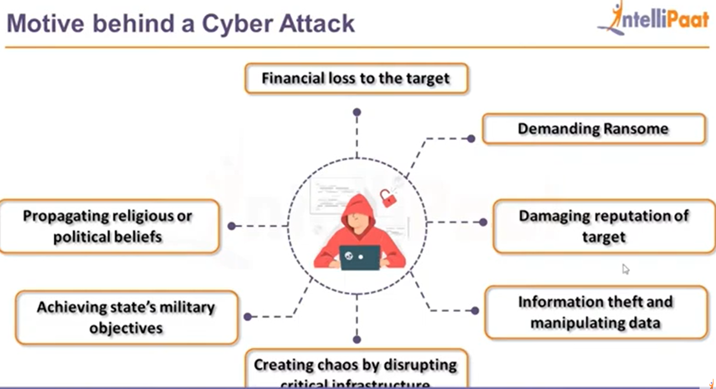
Motives behind Cyber Attacks

Slide 37
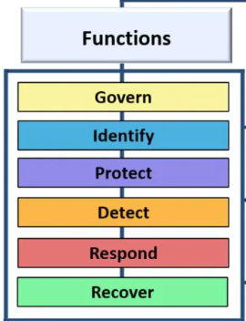
NIST Cybersecurity Framework

Slide 38
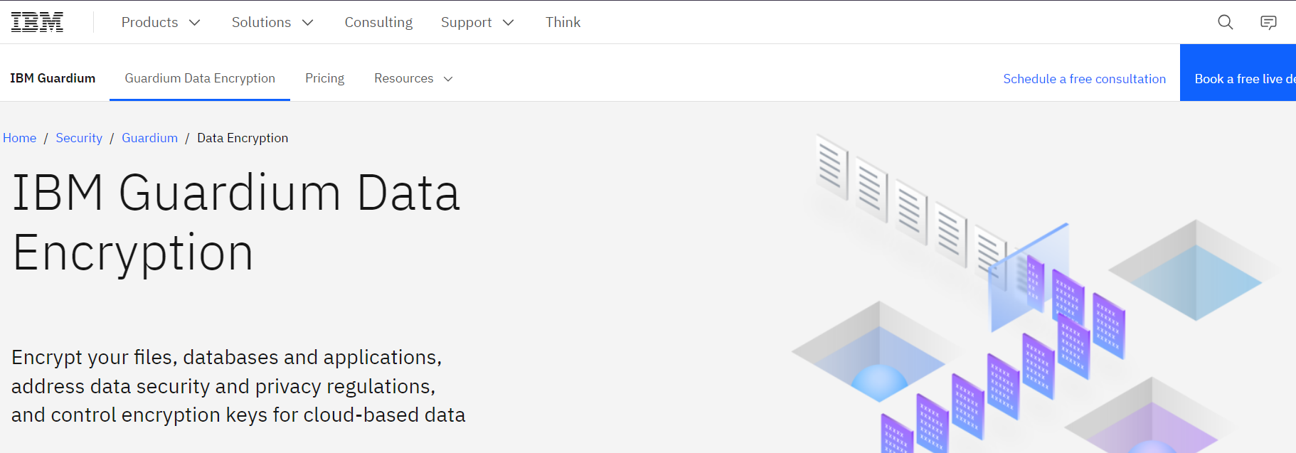
NIST Cybersecurity Framework
Govern: Define, communicate and monitor strategies, roles, risks and policies of the org.
Identify: Identify assets(data, hardware, identities, software) and perform cybersecurity risk assessments on the attack surface.
Protect: Ensure the core values of the CIA triad are implemented to manage security risks. (I.e. Crypto, MFAs, Pk, Backups).

Slide 39
NIST Cybersecurity Framework
Detect: Monitor and analyze anomalies and other potentially adverse events that may indicate occurring attacks using Security Incidents and Events Management (SIEM) tools.
Respond: Utilize tools like dynamic playbooks to contain the effects of cybersecurity incidents. This process involves incident management, analysis, mitigation, reporting, and communication.
Recover: Timely restoration of assets and operations affected by a cybersecurity incident.

Slide 40
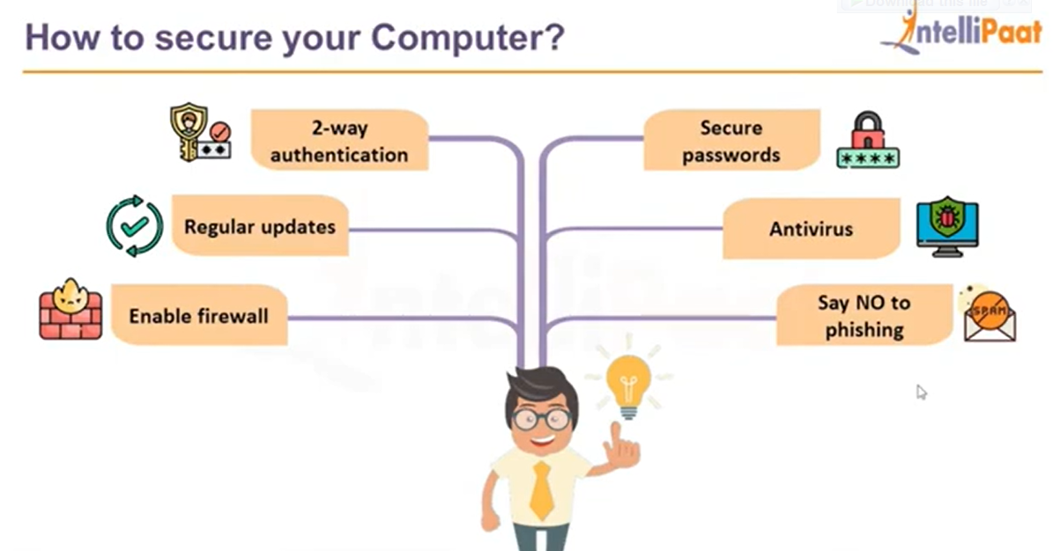
Threat Mitigation Strategie

Slide 41
Lecture review
Understand the evolution tracing its roots from early security practices to contemporary challenges.
Give an overview and the importance of cybersecurity.
Identify common cybersecurity threats, risks, and vulnerabilities that permeate digital ecosystems.
Assess the potential risks associated with cybersecurity threats to different types of organizations and systems.
Develop strategies to mitigate cybersecurity threats, and manage risks effectively

Slide 42
Thanks!
Do you have any questions?
amosmarvellous48@gmail.com
+234 702 625 4613

